Slide 1



Encryption in the microarchitectural world
Ping-Lun Wang, Fraser Brown, Riccardo Paccagnella,
Eyal Ronen, Riad S. Wahby, and Yuval Yarom
RWC, 03/09/2026

Slide 2


Arch vs. μArch components
Cache hierarchy
Branch predictor (BP)
…
Microarchitectural (μArch) components
µArch
ISA
Instruction set
Architectural registers
…
▲ CPU
Architectural (Arch) components
Credit: irasutoya.com

Slide 3

μWMs: hidden computers in the CPU
µWMs: difficult to analyze!
😎 Hides computational states
µArch weird machines (µWMs)
µArch
🤯 Prevents code analysis
ISA
😈 Defeats debuggers and emulators
🤔 Seems to be great for program obfuscation?
▲ CPU
Credit: irasutoya.com

Slide 4
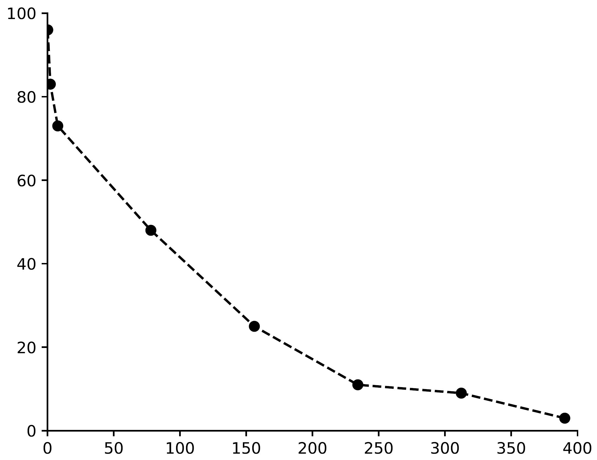
Existing µWMs need improvements…
💥 Not scalable for large computations
💥 Difficult to create new µWMs
Accuracy (%)
_32BitValueToCacheState(C_arch, C1, NULL);
_32BitValueToCacheState(D_arch, D1, NULL);
_32BitValueToCacheState(E_arch, E, NULL);
_32BitValueToCacheState(K[0], K0, NULL);
_32BitValueToCacheState(W_arch, W, NULL);
LeftShift(A1, A1, 27);
mfence();
lfence();
trash = _32BitAnd(B1, C1, B_AND_C, trash);
mfence();
lfence();
trash = _32BitNot(B2, NOT_B, trash);
mfence();
lfence();
trash = _32BitAnd(NOT_B, D1, NOT_B_AND_D, trash); … // 128 lines in total
Size (thousands of logic gates)

Slide 5



Our work: Flexo and Transient Arch Execution
Flexo
Transient Arch Execution
✨ Improved construction!
✨ New μWM: weird programs!
✨ Compiler for μWMs!
✨ Large state storage!
✨ μWM binary packer!
✨ 543× speedup!
ISA
ISA
Bending microarchitectural weird machines towards practicality [USENIX Security 24]
Transient architectural execution:
from weird gates to weird programs [SP 26]
Credit: irasutoya.com

Slide 6
Background
μWMs and weird computation

Slide 7


From Arch to μArch “weird” computation
Architectural Computation
Microarchitectural “Weird” Computation
✅
State: registers and memory
🔥
State: “weird” registers using μArch state
Architecturally visible
Cached = 1
Not cached = 0
✅
Compute: ISA instructions
🔥
Compute: hardware side-effects
ADD, AND, MOV, JMP
“Weird gates” compute with memory operations during transient execution
Credit: irasutoya.com

Slide 8
The construction of a weird gate
How weird gates work
1️⃣
Transient execution
1️⃣
Trigger transient execution
Inputs
in μArch
2️⃣
3️⃣
Outputs in μArch
2️⃣
Compute with input latency
Time
3️⃣
Access output weird registers
Init
Exec
End

Slide 9
The construction of a weird gate
Slow…
How weird gates work
Misprediction
if (condition()) {
tmp += out[in1[0] + in2[0]];
}
end();
1️⃣
Trigger transient execution
Branch misprediction, return address misprediction, etc.
2️⃣
Compute with input latency
Depending on the cache state, input weird registers may have different latency.
Cached → short cache hit
Not cached → long cache miss
BP predicts
(incorrectly)
condition()
returns
Transient execution
Cleanup tmp += …
Run end()
Run if(…)
Run tmp += …
3️⃣
Access output weird registers
Write the results to output weird registers via memory loads.
Time

Slide 10
The construction of a weird gate
How weird gates work
if (condition())
tmp += out[in1[0] + in2[0]];
1️⃣
Trigger transient execution
Branch misprediction, return address misprediction, etc.
Input weird registers
2️⃣
Compute with input latency
Depending on the cache state, input weird registers may have different latency.
Cached → short cache hit
Not cached → long cache miss
Cached
Value
available
Not cached
Value
available
3️⃣
Access output weird registers
Time
Write the results to output weird registers via memory loads.

Slide 11
The construction of a weird gate
How weird gates work
if (condition())
tmp += out[in1[0] + in2[0]];
1️⃣
Trigger transient execution
Branch misprediction, return address misprediction, etc.
Output weird register
2️⃣
Compute with input latency
Initial state: not cached
After execution
Result is 0: not cached
Result is 1: cached
Depending on the cache state, input weird registers may have different latency.
Cached → short cache hit
Not cached → long cache miss
3️⃣
Access output weird registers
Write the results to output weird registers via memory loads.

Slide 12
Prior work’s AND gate
if (condition())
tmp += out[in1[0] + in2[0]];
Misprediction
How the AND gate works
Transient execution
1️⃣
Trigger transient execution
condition() returns
Input
CPU mispredicts the branch and executes the gate transiently.
(1, 1)
out = 1
2️⃣
Compute with input latency
Both in1 and in2 are fetched at the same time (no dependency!)
Addition (in1[0] + in2[0]) is computed after the loads
(1, 0)
out = 0
(0, 1)
out = 0
3️⃣
Access output weird registers
out is fetched only when 2️⃣ finished before transient execution ends.
(0, 0)
out = 0
Time

Slide 13
Prior work’s other types of gates
if (condition()) {
tmp += out[in1[0]];
tmp += out[in2[0]];
}
if (condition()) {
tmp += out[in1[0]];
tmp += out[in2[0] + in3[0]];
}
OR
AND
▲ OR gate
▲ AND & OR gate
if (in[0])
tmp += out[delay()];
▲ NOT gate

Slide 14
Compose weird gates into weird circuits
out
✨ Flexo can do this in one gate!!
in1
in2
▲ Prior work’s XOR circuit (5 weird gates)

Slide 15
Flexo
Making weird gates much faster and much more accurate

Slide 16
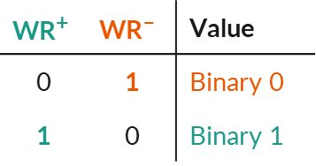
Flexo’s construction: differential encoding
WR
WR⁺
WR–
$$\text{WR}\text{+}$$ | $$\text{WR}\text{–}$$ | Value
0 | 1 | Binary 0
1 | 0 | Binary 1
Flexo
0 | 0 | Invalid!
1 | 1 | Invalid!
0/1
0/1
0/1

Slide 17
Differential encoding → many benefits!
+-
Flexo
✨ Powerful gates!
✨ Higher accuracy!
+-
+-

Slide 18
Applying Flexo’s differential encoding
in1 | in2 | out
1 | 0 | 1
0 | 1 | 1
1 | 1 | 0
0 | 0 | 0
out is 1 when in1 is 1 AND in2 is 0
out = in1 ∧ ¬in2
Flexo
out⁺ = in1⁺ ∧ in2–

Slide 19
Applying Flexo’s differential encoding
in1 | in2 | out
1 | 0 | 1
0 | 1 | 1
1 | 1 | 0
0 | 0 | 0
out⁺ = in1⁺ ∧ in2–
out⁺ = in1– ∧ in2⁺
out– = in1⁺ ∧ in2⁺
out– = in1– ∧ in2–
OR them together
out⁺ = (in1⁺ ∧ in2–) ∨ (in1– ∧ in2⁺)
out– = (in1⁺ ∧ in2⁺) ∨ (in1– ∧ in2–)
✨ Only AND & OR operations!!

Slide 20
New encoding → much more scalable gates!
in1 | in2 | out
1 | 0 | 1
0 | 1 | 1
1 | 1 | 0
0 | 0 | 0
if (condition()) {
tmp += out_p[in1_p[0] + in2_m[0]];
tmp += out_p[in1_m[0] + in2_p[0]];
tmp += out_m[in1_p[0] + in2_p[0]];
tmp += out_m[in1_m[0] + in2_m[0]];
}
OR operators
AND operators
✨ Any gate with ≤ 4 inputs works!!
E.g., 4-bit XOR or 2-bit adder

Slide 21
Error correction with dynamic voting
+-
Run 1: 1
Run 2: 1
Run 3: 1
Run 4: 1
Run 5: 0
→ Output 1
Run 1: Invalid!
Run 2: Invalid!
Run 3: 1
→ Output 1
+-
+-
Prior work (GoT^{[1]}): 3-out-of-5 voting
Flexo: rerun only when error occurs
✨ Higher accuracy & less overhead!!
[1] The Gates of Time: Improving Cache Attacks with Transient Execution, Katzman et al., USENIX Security ‘23

Slide 22
Flexo’s compiler: the first compiler for μWMs
_32BitValueToCacheState(C_arch, C1, NULL);
_32BitValueToCacheState(D_arch, D1, NULL);
_32BitValueToCacheState(E_arch, E, NULL);
_32BitValueToCacheState(K[0], K0, NULL);
_32BitValueToCacheState(W_arch, W, NULL);
LeftShift(A1, A1, 27);
mfence();
lfence();
trash = _32BitAnd(B1, C1, B_AND_C, trash);
mfence();
lfence();
trash = _32BitNot(B2, NOT_B, trash);
mfence();
lfence();
trash = _32BitAnd(NOT_B, D1, NOT_B_AND_D, trash);
mfence();
lfence();
trash = _32BitOr(B_AND_C, NOT_B_AND_D, B_AND_C_OR_NOT_B_AND_D, trash);
mfence();
lfence();
trash = _32BitAdder_impl(A1, B_AND_C_OR_NOT_B_AND_D, SUM_1, WORDSIZE, trash);
mfence();
lfence();
…
void __weird__sha1_round(
unsigned* input,
unsigned* output, unsigned* error_output
) {
unsigned a = input[0];
unsigned b = input[1];
unsigned c = input[2];
unsigned d = input[3];
unsigned e = input[4];
unsigned w = input[5];
unsigned k = 0x5A827999;
unsigned f = (b & c) | ((~b) & d);
unsigned temp = ROL(a, 5) + f + e + w + k;
output[0] = temp;
output[1] = a;
output[2] = ROL(b, 30);
output[3] = c;
output[4] = d;
}
😇 No low-level details
✨ Optimizations!
(21 lines in total)
(128 lines in total)

Slide 23



UPX + Flexo: the first μWM binary packer
</>
Compress
Encrypt
Pack
Decompress
Decrypt
(Using Flexo)
chksum
Unpack
chksum
UPX + WM
Input program
Packed program
Roughly 1 minute to unpack 132 KB using Simon
(5 minutes using AES)
Slower, but defeats anti-virus tools!

Slide 24
Limitations of weird gates
Branches and memory operations are not scalable
A weird register can only store 1 bit
A weird gate can only compute 4 bits at a time
🤔 Can we make μWMs more powerful?

Slide 25
Transient Arch Exec
From weird gates to weird programs

Slide 26
Transient arch exec: μArch state + Arch compute
Architectural Computation
Microarchitectural “Weird” Computation
✅
State: registers and memory
1️⃣ μArch to Arch
🔥
State: “weird” registers using μArch state
Architecturally visible
Cached = 1
Not cached = 0
✅
Compute: ISA instructions
🔥
Compute: hardware side-effects
ADD, AND, MOV, JMP
3️⃣ Arch to μArch
“Weird gates” compute with transient memory operations
2️⃣ Arch compute
Plan: run 1️⃣2️⃣3️⃣ in one transient execution window
Credit: irasutoya.com

Slide 27
Convert cache states to Arch states
input[0] is set to 0 architecturally
Return value (during transient execution):
input is cached: return 1
input is not cached: return 0
int cache2arch(int *input) {
if (input[0]) return 0;
else return 1;
}

Slide 28
Convert cache states to Arch states
int cache2arch(int *input) {
if (input[0]) return 0;
else return 1;
}
int cache2arch(int *input) {
if (input[0]) return 0;
else return 1;
}
0
???
Misprediction
Cached
Not cached

Slide 29
Weird functions: new computational abilities
✨ Powerful instructions (e.g., AES-NI)!
if (condition()) {
int tmp_in1 = cache2arch(in1);
int tmp_in2 = cache2arch(in2);
if (tmp_in1 ^ tmp_in2) load(out);
}
✨ Branch instructions!
✨ Dynamically access weird registers!
✨ Access to the (read-only) main memory!
✨ Can be composed into weird programs!
Details in our paper!

Slide 30


Takeaways
✨ Flexo: fast and accurate weird gates with compiler support
▲ Flexo
▲ TAE
✨ Transient Arch Exec: weird programs with powerful computational abilities
✨ μWMs are practical for program obfuscation or other attacks
Bending microarchitectural weird machines towards practicality
Transient architectural execution: from weird gates to weird programs
Contact: Ping-Lun Wang, pinglunw@andrew.cmu.edu

